Slide 1
Online Meme is Online
Dominic DiFranzo

Slide 2
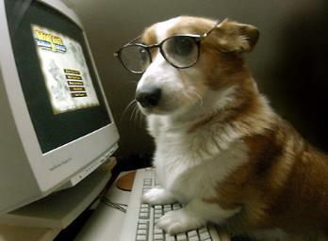
Outline
Introduction to Meme theory
Criticism of Meme theory
Online Memes
Attributes of Online Memes
Hashtags and memes in Twitter

Slide 3
Meme
First coined by Richard Dawkins’ 1976 book, The Selfish Gene.
Defined as a unit of culture.
Memes are copied by hosts (humans) to other hosts, can change when copied, and compete for survival.
these conditions allow for Darwinian evolution.
Similar to genes in bio evolution.
Extremely high mutation rate
Notes:
Memes spread through the behaviors that they generate in their hosts. Memes that propagate less prolifically may become extinct, while others may survive, spread and (for better or for worse) mutate. Memes that replicate most effectively enjoy more success. Some memes may replicate effectively even when they prove to be detrimental to the welfare of their hosts.

Slide 4
The Meme Machine
Famous book by Blackmore. Coined new terms in Meme theory.
Copy-the-product: copy based only on finished product. Difficult, prone to high mutation rate, mutation will be found in copies/children
Copy-the-instructions: Copy based on instruction, not the product. Less prone to error/mutations. Errors will not be passed in copies.
Memeplex: Memes that are replicated together, such as religions and cultures.

Slide 5
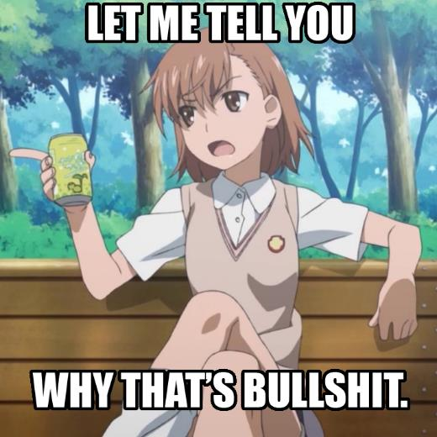
Criticism of Meme Theory

Slide 6
Criticism of Meme Theory
Atran (2006) communication of ideas generally trigger or elicit ideas in other minds through inference and not replication or imitation.
  Ten Commandments study
  Inferential capacity and autism study
Humans make poor Meme Machines.
Notes:
Despite the subjects' own expectations of consensus, interpretations of the commandments showed wide ranges of variation, with little evidence of consensus. In another experiment, subjects with autism and subjects without autism interpreted ideological and religious sayings (for example, "Let a thousand flowers bloom" or "To everything there is a season"). People with autism showed a significant tendency to closely paraphrase and repeat content from the original statement (for example: "Don't cut flowers before they bloom"). Controls tended to infer a wider range of cultural meanings with little replicated content (for example: "Go with the flow" or "Everyone should have equal opportunity"). Only the subjects with autism—who lack the degree of inferential capacity normally associated with aspects of theory of mind—came close to functioning as "meme machines"

Slide 7
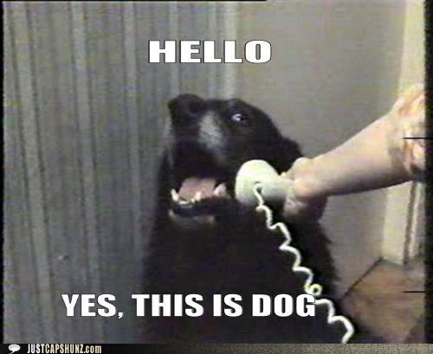
Online Meme
UknTW.jpg

Slide 8

Online Meme

Slide 9
Attributes of Memes
Humor - Knobel and Lankshear (2007) found that this served as a central component in many online memes
  Playfulness
  Incongruity
  Superiority
Simplicity – The easier the content/idea is, the easier it to copy/imitate/change/remix it

Slide 10
Bad Content/ Good Meme
Unfinished, unpolished, amateur-looking and sometimes even weird media invites people to fill in the gaps.
Different from many viral or popular media that made be very polished and professional.
Invites people to create new meaning.

Slide 11
Why Memes?
As a way for people to succeed in the ‘attention economy' (Lanham, 2006)
‘networked individualism' (Wellman et al., 2003) – a way to both show our individualism while keeping to the trends in our community.
cultural and esthetic logics of participation – Memes as building blocks of larger complex cultures.

Slide 12
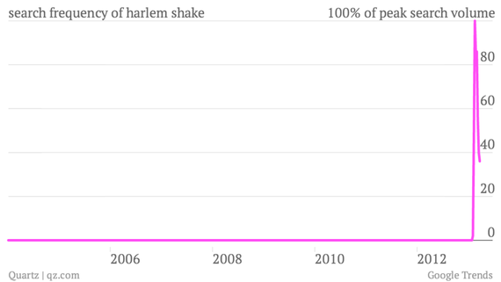
Meme’s for Money

Slide 13
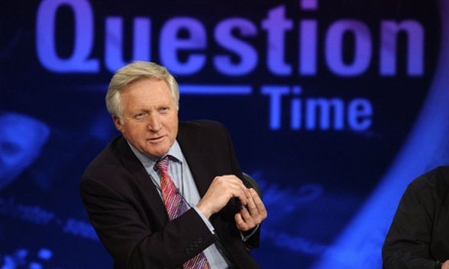

Slide 14
Works Cited
Benitez-Bribiesca, Luis (2001): Memetics: A dangerous idea. Interciecia 26: 29–31, p. 29.
Blackmore, Susan (2003). "Consciousness in meme machines". Journal of Consciousness Studies (Imprint Academic).
The Selfish Gene by Richard Dawkins, Oxford University Press, 1976, 2nd edition, December 1989, hardcover, 352 pages,

